Slide 1

DEPARTMENT OF COMPUTER SCIENCE & ENGINEERING
SCHOOL OF COMPUTING
1156CS701- MAJOR PROJECT(INHOUSE)
WINTER SEMESTER 2023-2024
REVIEW - II
“ENHANCING INSURANCE CLAIM INTEGRITY USING MACHINE LEARNING FOR FRAUD DETECTION AND ANALYSIS”
SUPERVISED BY
Dr. S.Lalitha
Associate Professor
PRESENTED BY
Y.Karunkumar (VTU 18059)(20UECS1037)
M.V.VishnuvardhanReddy(VTU16707)(20UECS0603)
Y.Ramanareddy (VTU 16717)(20UECS1046)

Slide 2
AGENDA
ABSTRACT
OBJECTIVE
INTRODUCTION
LITERATURE REVIEW (SOFT COPY OF PAPERS TO BE LINKED AS HYPERLINK)
DESIGN AND METHODOLOGIES
IMPLEMENTATION
TESTING
INPUT AND OUTPUT
INCLUDE DEMO VIDEO-1 (Till REVEW-1)
INCLUDE DEMO VIDEO-2(Complete Implementation of Project)
CONCLUSION
WEB REFERENCES LINK (TILL REVIEW DATE ALL LINKS TO BE INCLUDED DAY WISE)
PLAGIARISM REPORT OF PPT
REFERENCES

Slide 3
ABSTRACT
Insurance Company working as commercial enterprise from last few years have been experiencing fraud cases for all type of claims.
Amount claimed by fraudulent is significantly huge that may causes serious problems, hence along with government, different organization also working to detect and reduce such activities.
Such frauds occurred in all areas of insurance claim with high severity such as insurance claimed towards auto sector is fraud that widely claimed and prominent type, which can be done by fake accident claim.
The aim of the project is to develop a system that analyzes insurance claim datasets to detect fraudulent and fake claims amounts.
The project implement machine learning algorithms to build model to label and classify claim.

Slide 4
OBJECTIVES
Aim of the Project:
The aim of the project is to use machine learning to detect and reduce fraudulent insurance claims, particularly in the auto sector, by analyzing a dataset and implementing classification algorithms
Scope of the Project:
This research aims to identify what are the major determinants of fraud claims and proposed a machine learning solution for detecting fraud claims. Past claim data will be analyzed with underwriting details.

Slide 5
INTRODUCTION
Insurance fraud presents a significant challenge for insurance companies worldwide, resulting in financial losses and higher premiums. Detecting and preventing fraudulent claims is essential for industry integrity and fairness. Traditional methods rely on manual investigation and rule-based systems, limiting adaptability.
Machine learning is a powerful tool for enhancing fraud detection in insurance claims. By analyzing vast datasets, ML algorithms can identify patterns indicative of fraudulent activity. This enables insurance companies to detect fraud more effectively and proactively address complex schemes.
In this project, the application of machine learning in fraud detection and analysis for insurance claims is explored. Various ML algorithms and techniques are discussed that can be employed to detect fraudulent claims, including supervised learning and anomaly detection. Furthermore, the project delves into feature engineering, model evaluation, and deployment strategies tailored specifically to the insurance fraud detection domain.

Slide 6
LITERATURE REVIEW
Matheus Kempa, Yaohao Peng, 2021, “Machine learning algorithms for fraud prediction in property insurance”
This paper presents an exploration of machine learning algorithms tailored for predicting fraud in property insurance. It discusses various techniques and advancements in data analysis within the insurance industry, focusing on the application of machine learning models. The paper highlights the challenges of fraud detection in property insurance and proposes innovative approaches to enhance prediction accuracy.

Slide 7
LITERATURE REVIEW
Elsevier , 2022 ,“Insurance Fraud Detection: Evidence from Artificial Intelligence and Machine Learning”
The project investigates how artificial intelligence and machine learning can improve insurance fraud detection. It examines data to find patterns and anomalies indicating fraud in insurance claims. By comparing different AI and ML techniques, the study aims to enhance fraud detection in the insurance industry, providing valuable insights for insurers and policymakers.

Slide 8
LITERATURE REVIEW
Jenita Mary and S. P. Angelin Claret , 2022,“Analytical study on fraud detection in healthcare insurance claim data using machine learning classifiers”
This paper explores the application of machine learning classifiers in detecting fraud within healthcare insurance claims. The authors investigate various classifiers and evaluate their effectiveness in identifying fraudulent activities within the healthcare insurance domain.

Slide 9
LITERATURE REVIEW
Adedayo, F. Adedotun, Oluwaseun A. Odusanya, Olumide S. Adesina, J.A. Adeyiga, and O. Oyewole , 2022,“Prediction of Automobile Insurance Fraud Claims Using Machine Learning”
The paper focuses on utilizing machine learning algorithms to predict fraud in automobile insurance claims. It presents an in-depth exploration of various machine learning techniques and their application in detecting fraudulent activities. The study aims to enhance prediction accuracy and mitigate financial risks for insurers by developing effective fraud detection models.

Slide 10
LITERATURE REVIEW
Mary Arockiam, Jenita, and Seraphim Pushpanathan Angelin Claret , 2023,“MapReduce-Iterative Support Vector Machine Classifier: Novel Fraud Detection Systems in Healthcare Insurance Industry”
This paper introduces an innovative approach to fraud detection in the healthcare insurance industry through the utilization of MapReduce-Iterative Support Vector Machine (SVM) classifiers. The study presents a novel system that merges the scalability of MapReduce with the precision of SVM classifiers to efficiently identify fraudulent activities in healthcare insurance claims. By incorporating advanced data processing techniques and machine learning algorithms, the proposed system aims to enhance fraud detection accuracy, thereby bolstering the effectiveness and dependability of healthcare insurance operations. The research contributes to the advancement of robust fraud detection mechanisms tailored specifically for the healthcare insurance domain, addressing the escalating demand for proficient fraud prevention strategies in this sector.

Slide 11
DESIGN AND METHODOLOGIES
MODULE 1 : Data Collection and Pre-processing
MODULE 2 : Feature Selection and Splitting the Data
MODULE 3 : Model Selection and Training
MODULE 4 : Evaluation, Deployment and Maintenance

Slide 12
MODULE 1: Data Collection and Pre-processing
Determine the specific data attributes needed for fraud detection in insurance claims, such as claim details, policyholder information, transaction history, etc.
Data Collection: Collect comprehensive datasets from reliable sources containing information relevant to insurance claims, ensuring data integrity and completeness.
Data Cleaning: Handle missing values, outliers, and inconsistencies in the data. Ensure data quality before proceeding to the next steps.
Feature Engineering: Extract relevant features from the raw data that could help in distinguishing between legitimate and fraudulent claims. This could include variables like claim amount, claim type, policyholder information, claim history, etc.
Data Transformation: Normalize or scale the features to ensure they are on similar scales. Convert categorical variables into numerical representations through techniques like one-hot encoding or label encoding.

Slide 13
MODULE 2: Feature Selection and Splitting the Data
Feature Selection: Choose the most relevant features for detecting insurance fraud. Use techniques like correlation analysis, feature importance ranking, or domain expertise to select the subset of features that are likely to contribute most to the model's performance.
Splitting the Data: Divide the dataset into training, validation, and test sets. Typically, the data is split into around 70-80% for training, 10-15% for validation, and 10-15% for testing. Ensure that each set contains a representative sample of both legitimate and fraudulent claims.

Slide 14
MODULE 3: Model Selection and Training
Model Selection: Choose appropriate machine learning algorithms for fraud detection. Commonly used algorithms include:
Logistic Regression
Decision Trees
Stochastic Gradient Descent (SGD)
Support Vector Machines (SVM)
Naive Bayes
Voting Classifier
Model Training: Train the selected model using the training dataset. During training, the model learns patterns from the input data and adjusts its parameters to minimize a specified loss function.

Slide 15
MODULE 4: Evaluation, Deployment and Maintenance
Hyperparameter Tuning: Fine-tune the model's hyperparameters using the validation set to improve its performance. Hyperparameters control aspects of the model such as learning rate, tree depth, regularization strength, etc.
Model Evaluation: Evaluate the trained model's performance using the test set. Use evaluation metrics such as accuracy, precision, recall, F1-score, and ROC-AUC to assess how well the model identifies fraudulent claims.
Model Deployment: Deploy the trained model into the production environment where it can be used to automatically flag potentially fraudulent insurance claims in real-time. Ensure that proper monitoring and logging mechanisms are in place to track the model's performance and any potential issues.
Monitoring and Maintenance: Continuously monitor the model's performance in the production environment and update it as needed to adapt to evolving fraud patterns or changes in the data distribution. Regularly retraining the model with new data helps ensure its effectiveness over time.

Slide 16
IMPLEMENTATION
ARCHITECTURE DIAGRAM
DATA FLOW DIAGRAM
ER DIAGRAM
SEQUENCE DIAGRAM

Slide 17
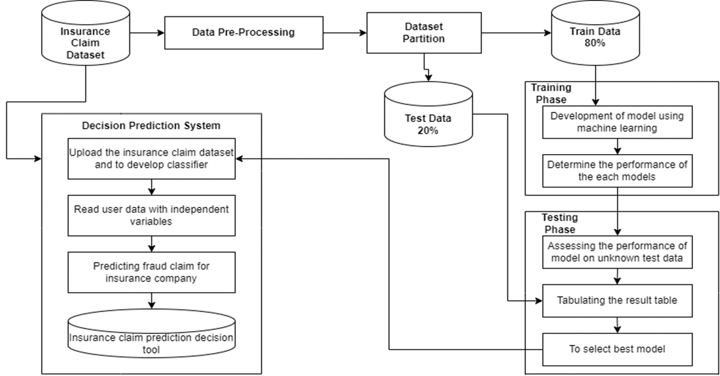
ARCHITECTURE DIAGRAM

Slide 18
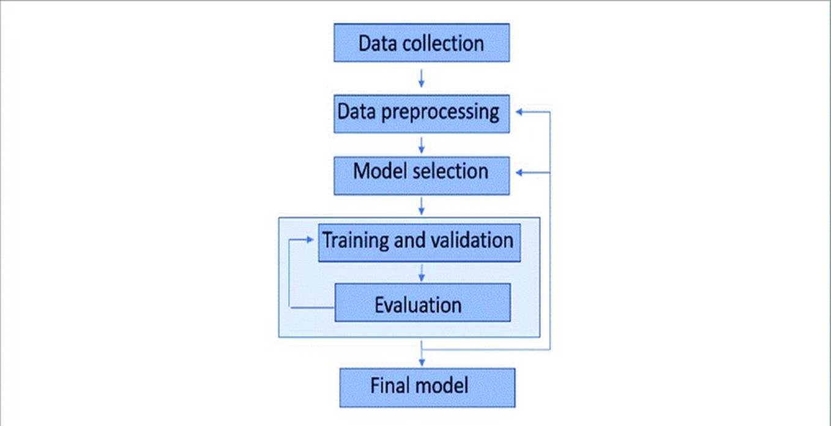
DATA FLOW DIAGRAM

Slide 19
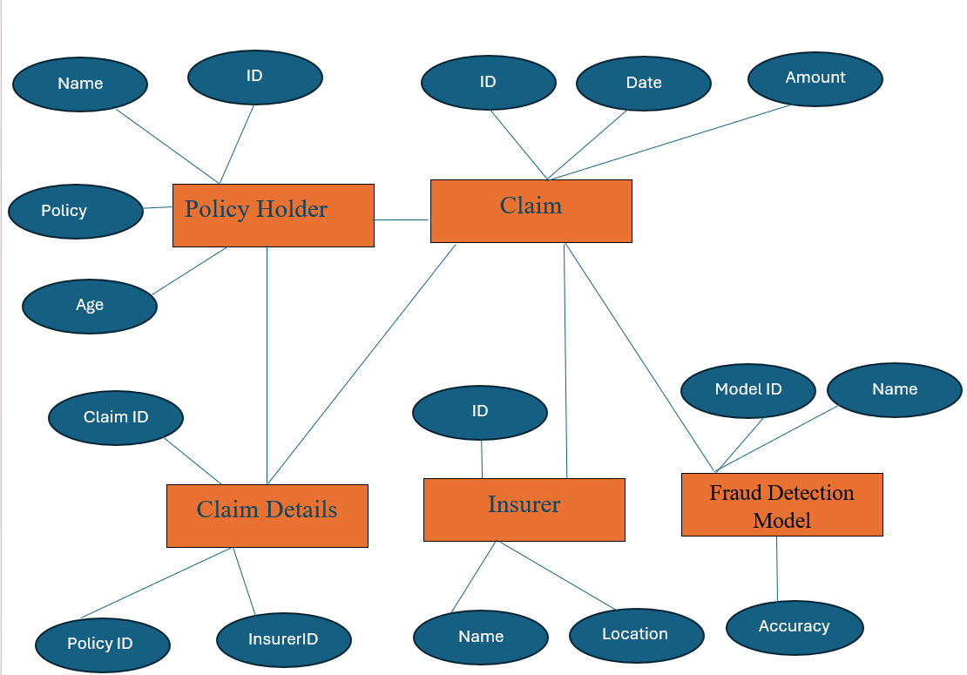
ER DIAGRAM

Slide 20
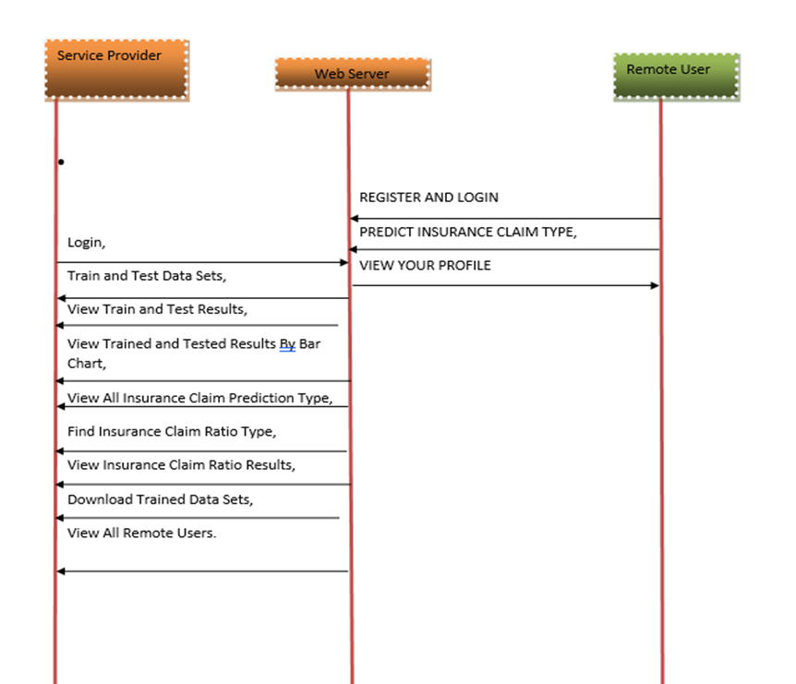
SEQUENCE DIAGRAM

Slide 21
TESTING
UNIT TESTING
INTEGRATION TESTING
FUNCTIONAL TESTING
WHITE BOX TESTING
BLACK BOX TESTING

Slide 22
UNIT TESTING
Unit testing involves the design of test cases that validate that the internal program logic is functioning properly, and that program inputs produce valid outputs. All decision branches and internal code flow should be validated. It is the testing of individual software units of the application . It is done after the completion of an individual unit before integration. This is a structural testing, that relies on knowledge of its construction and is invasive. Unit tests perform basic tests at component level and test a specific business process, application, and/or system configuration. Unit tests ensure that each unique path of a business process performs accurately to the documented specifications and contains clearly defined inputs and expected results.

Slide 23
INTEGRATION TESTING
Integration tests are designed to test integrated software components to determine if they actually run as one program. Testing is event driven and is more concerned with the basic outcome of screens or fields. Integration tests demonstrate that although the components were individually satisfaction, as shown by successfully unit testing, the combination of components is correct and consistent. Integration testing is specifically aimed at exposing the problems that arise from the combination of components.

Slide 24
FUNCTIONAL TESTING
Functional tests provide systematic demonstrations that functions tested are available as specified by the business and technical requirements, system documentation, and user manuals.
Functional testing is centered on the following items:
Valid Input : Identified classes of valid input must be accepted.
Invalid Input : Identified classes of invalid input must be rejected.
Functions : Identified functions must be exercised.
Output : Identified classes of application outputs must be
exercised.
Systems/Procedures: interfacing systems or procedures must be invoked.

Slide 25
WHITE BOX TESTING
White Box Testing is a testing in which in which the software tester has knowledge of the inner workings, structure and language of the software, or at least its purpose. It is purpose. It is used to test areas that cannot be reached from a black box level.
BLACK BOX TESTING
Black Box Testing is testing the software without any knowledge of the inner workings, structure or language of the module being tested. Black box tests, as most other kinds of tests, must be written from a definitive source document, such as specification or requirements document, such as specification or requirements document. It is a testing in which the software under test is treated, as a black box .you cannot “see” into it. The test provides inputs and responds to outputs without considering how the software works.

Slide 26
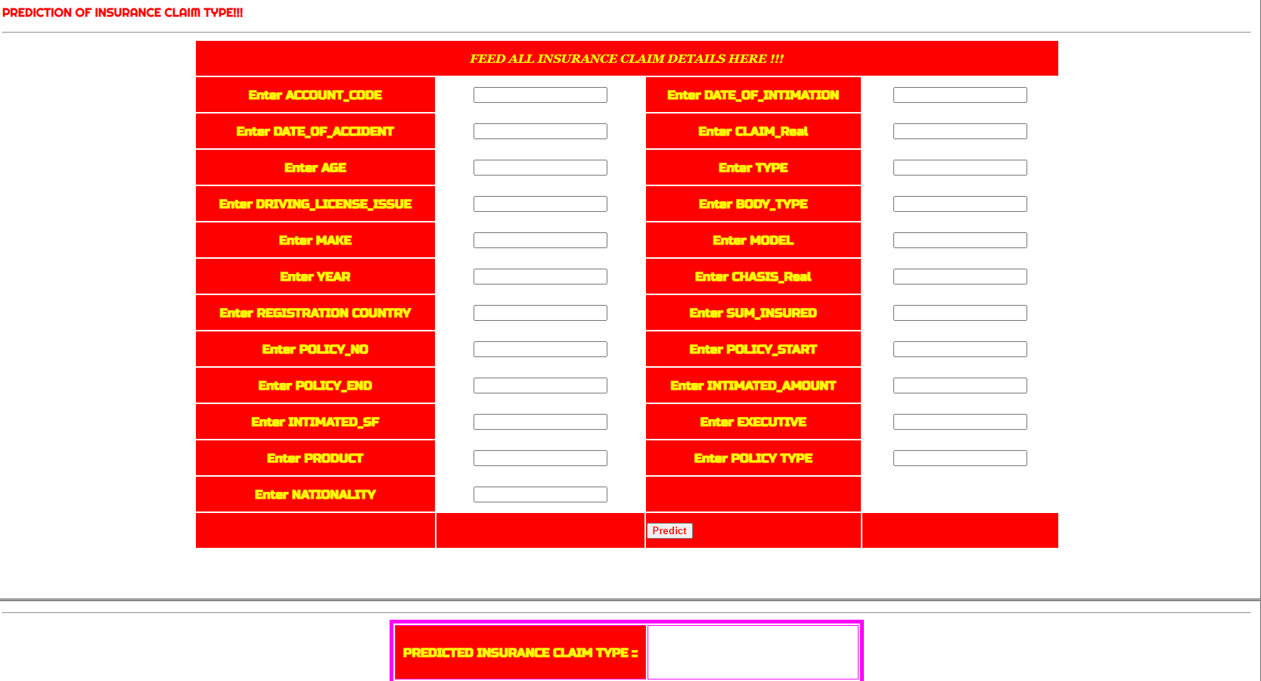
INPUT

Slide 27
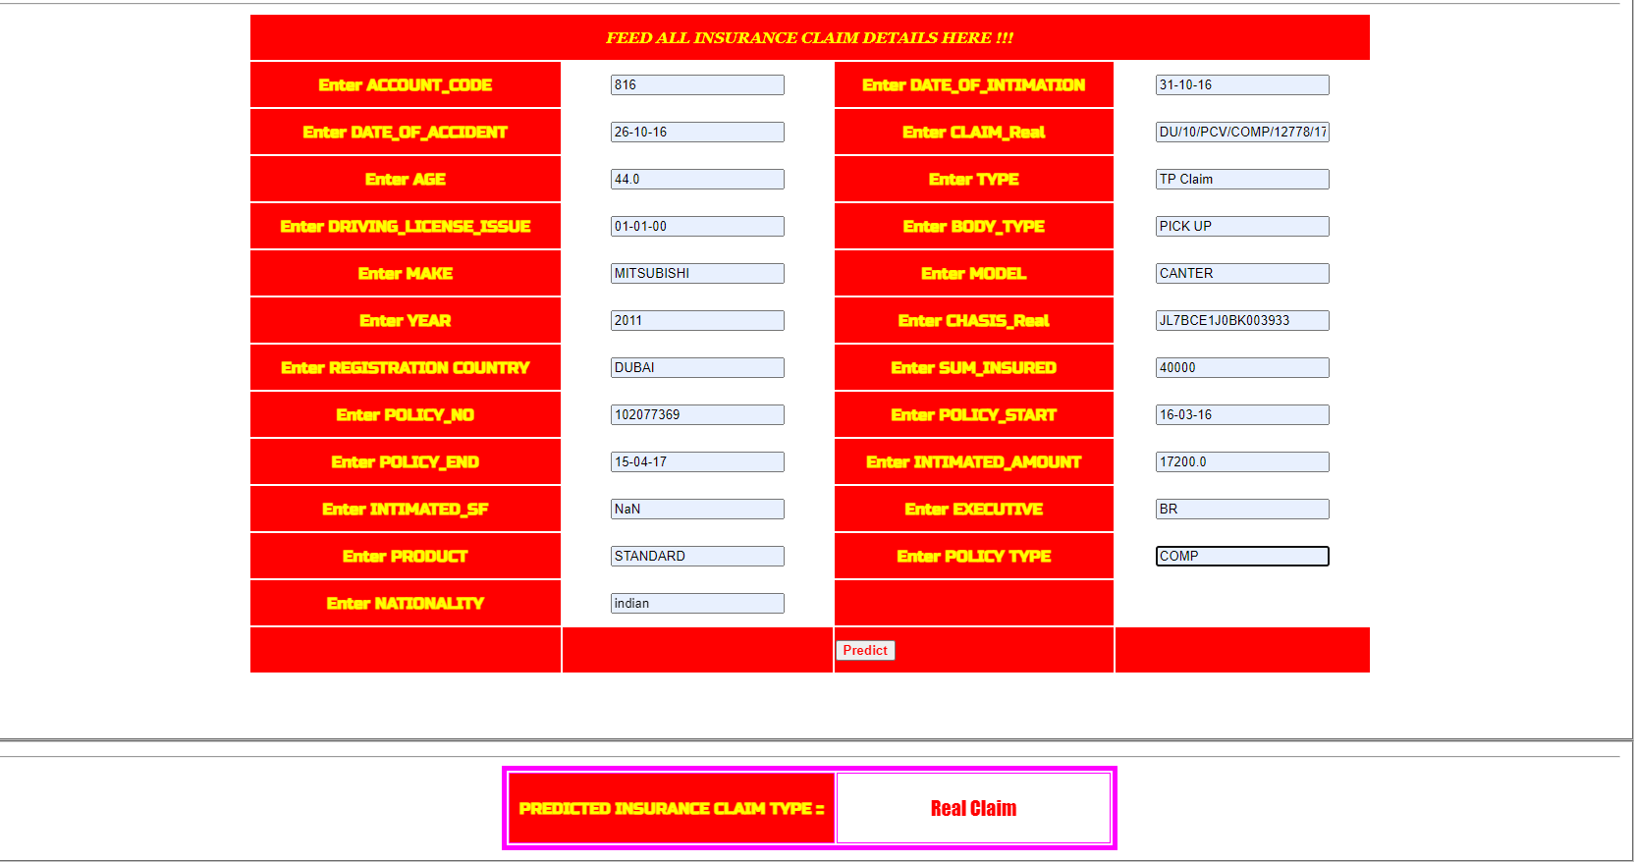
OUTPUT

Slide 28
CONCLUSION
The application of machine learning in fraud detection and analysis within the insurance industry represents a significant advancement in mitigating financial losses and preserving the integrity of insurance operations. Through the utilization of sophisticated algorithms insurers can effectively identify and prevent fraudulent activities, thereby safeguarding their financial interests and maintaining trust among stakeholders.

Slide 29
REFERENCES
Severino, M. K., & Peng, Y. (2021). Machine learning algorithms for fraud prediction in property insurance: Empirical evidence using real-world microdata. Journal of Insurance Analytics, vol. 5, no. 1, 2021, pp. 45-58.
Elsevier. (2022). Insurance Fraud Detection: Evidence from Artificial Intelligence and Machine Learning. Journal of Insurance Analytics, vol.7,no.3, pp.210-225.
Mary, A. Jenita, and S. P. Angelin Claret. "Analytical Study on Fraud Detection in Healthcare Insurance Claim Data Using Machine Learning Classifiers." Journal of Healthcare Analytics, vol. 8, no. 2, 2022, pp. 145-162.

Slide 30
REFERENCES
Adedayo, F. Adedotun, Oluwaseun A. Odusanya, Olumide S. Adesina, J.A. Adeyiga, Hilary I. Okagbue, and O. Oyewole. "Prediction of Automobile Insurance Fraud Claims Using Machine Learning." Journal of Insurance Analytics, vol. 6, no. 2, 2022, pp. 87-102.
Mary Arockiam, Jenita, and Seraphim Pushpanathan Angelin Claret. "MapReduce-Iterative Support Vector Machine Classifier: Novel Fraud Detection Systems in Healthcare Insurance Industry." Journal of Healthcare Informatics Research, vol. 12, no. 3, 2023, pp. 211-226.
Caruana, Mark Anthony, and Liam Grech. "Automobile Insurance Fraud Detection." Journal of Fraud Detection and Prevention, vol. 9, no. 4, 2023, pp. 301-315...

